Slide 1
A New Generation of LBTO User Software
Dr. Michelle L. Edwards
Instrument Support Astronomer and Q-Dev Project Scientist
On Behalf of the Q-Dev Team: D. Summers, J. Astier,
I. Suarez Sola, C. Veillet, J. Power, A. Cardwell, S. Walsh

Slide 2
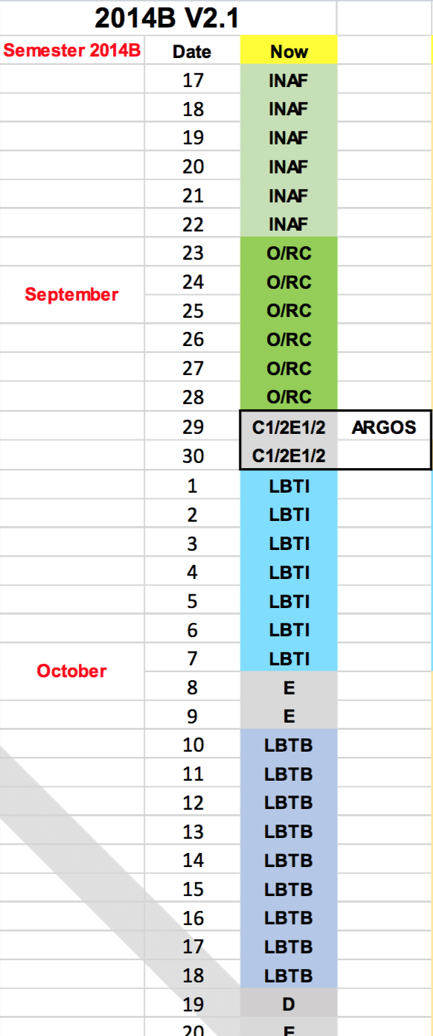
Current Model
Multi-instrument, mixed classical and service observing
Discrete blocks assigned to individual partners
Nighttime observing staffed by an on-site telescope operator.
Staff astronomers offer 2 nights of training for visiting observers followed by on-call support

Slide 3
Impetus for Change
LBTO is uniquely poised to be an early entry into the field of next generation of Extremely Large Telescopes (ELTs)
Urgency to maximize scientific output in this critical time, spurred re-evaluation of tools available to users
Conclusion: LBTO was behind what other observatories offered
No proposal tool: no forewarning for technically difficult projects
Non-uniform facility instrument tools lacked unified look/feel
Script preparation tools offered little or no visualization
No universal night planning tool

Slide 4
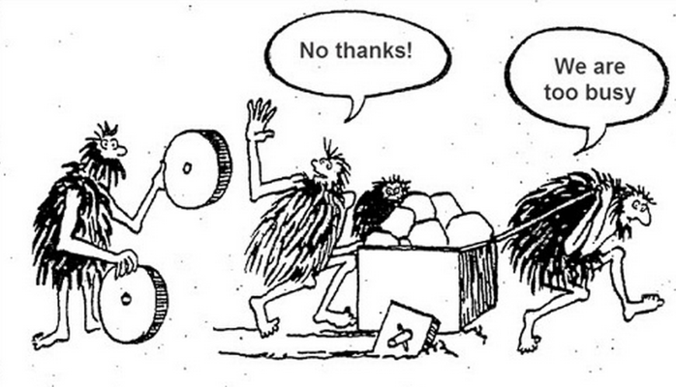
The Path Forward:
Created a development team (July 2014) and multi-cycle project plan
Identified and researched user tools available in the community
Surveyed available tools with focus on availability of code, ease of reuse, maturity and stability
Remain open to pathways to improve existing products and models to meet the needs of our community

Slide 5
Findings:
Software improvements for proposal submission, script preparation, service observation, and data qualification and distribution
Adopted Gemini Software tools: PIT (proposals), OT (script preparation); possibly QPT (queue planning tool)
Identified “delta” software requirements to adapt legacy Gemini software to LBTO instruments and site
Defined new development: Binocular Planning Tool
Created and staffed accompaniment projects (documentation, calibration standardization, overhead characterization, ETCs)

Slide 6
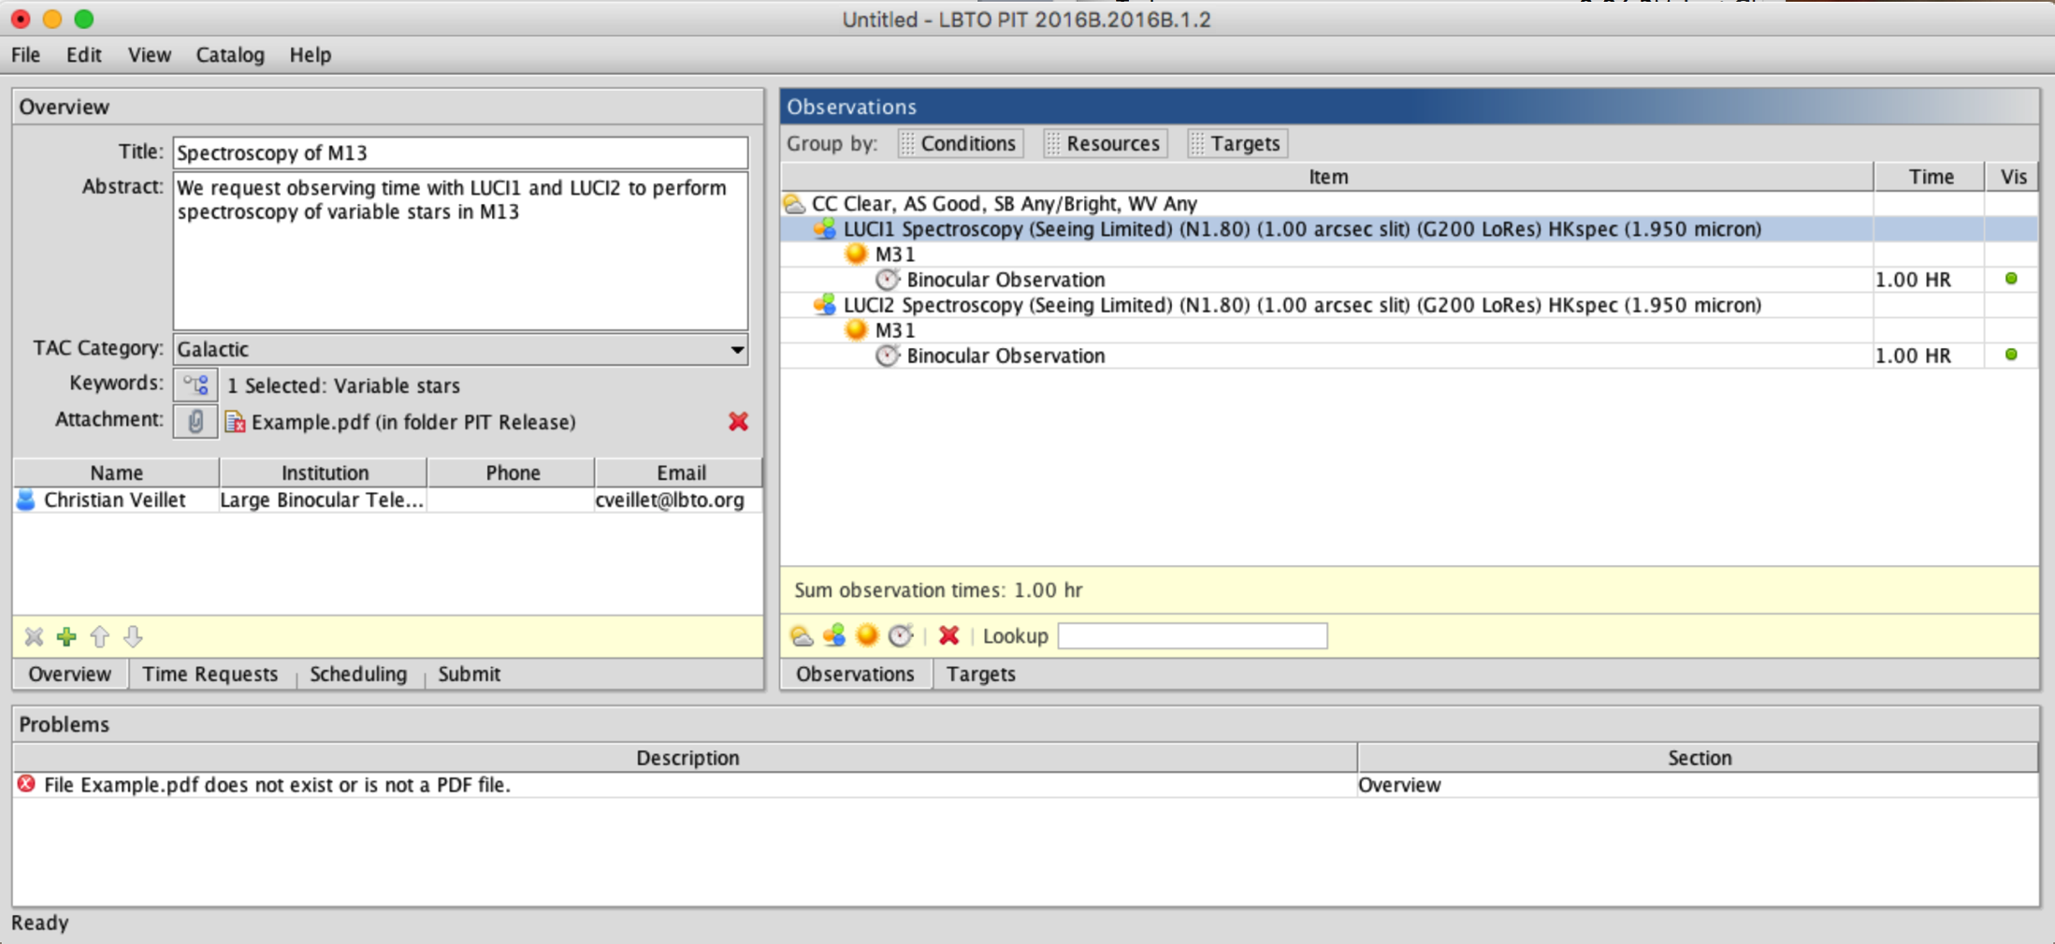
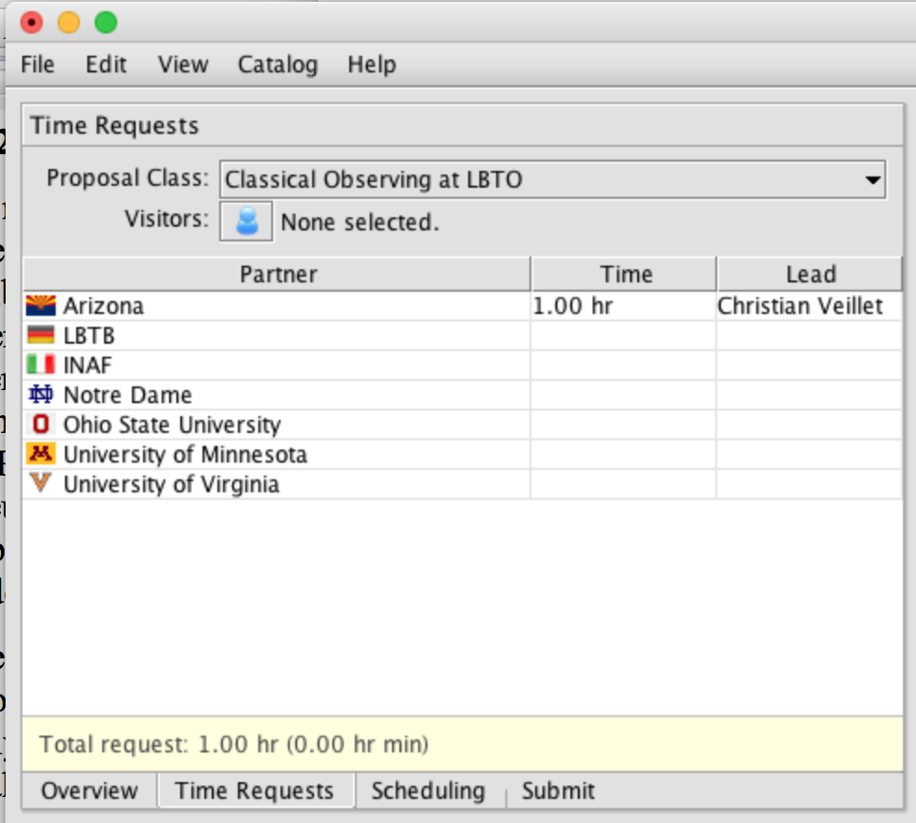
LBTO Phase I Tool

Slide 7
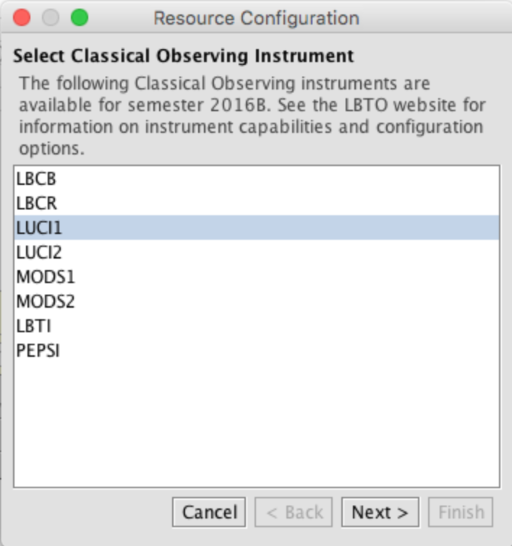
LBTO Phase I Tool

Slide 8
Deliverables
PIT first released in Sept 2015. 5 semesters now successfully completed.
PIT Webpage released in Sept 2015. Continuing work to improve and expand
Currently, 7 partners are using the PIT, including TSIP/NOAO
Summary spreadsheets and final proposals provided to all TAC/PC leads according to their deadlines.
Technical reviews also offered to partners. TSIP/NOAO agreed and ISAs completed the first very successful technical review process in March 2017

Slide 9
Lessons Learned
Different CfP dates and deadlines spread over 3.5 months are somewhat challenging to manage
Firewall issues troubled submitters at certain institutes; slowly resolving.
Fully-binocular realization needed as binocular becomes more popular
E-mail alerts for submitted proposals requested. Work in progress!
Clone functions for PIs with extensive target lists and identical set-ups
Strategic and PI instruments currently are not fully specified.

Slide 10
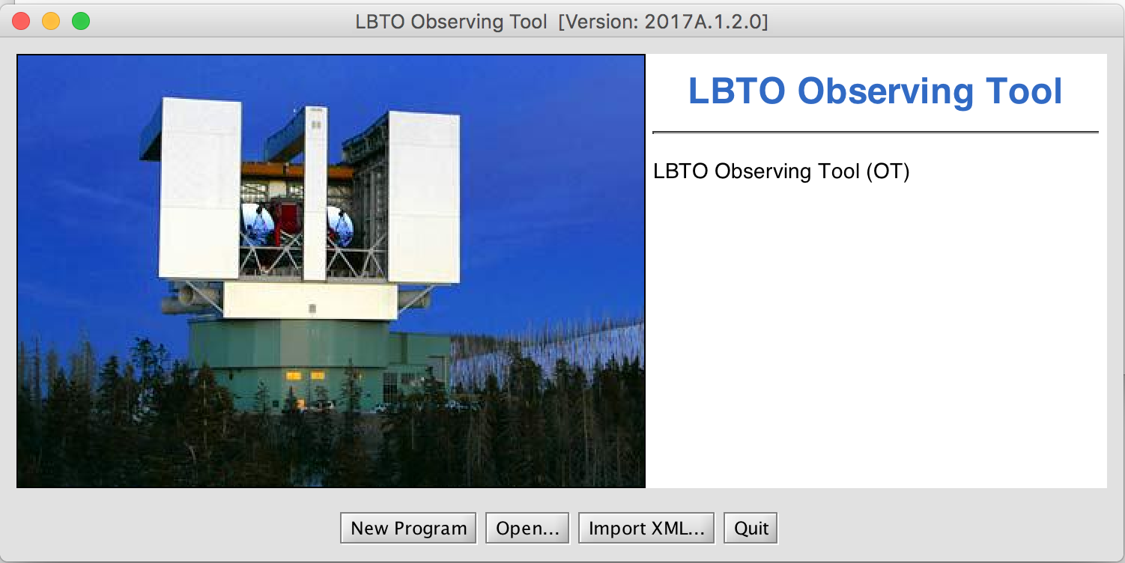
OT Introduction
The OT or Observing Tool is a cross-platform GUI-based software that PIs use to create scripts for all LBTO facility instruments
Scripts contain all the details necessary for a science observation, including telescope and instrument configurations and exposure settings

Slide 11
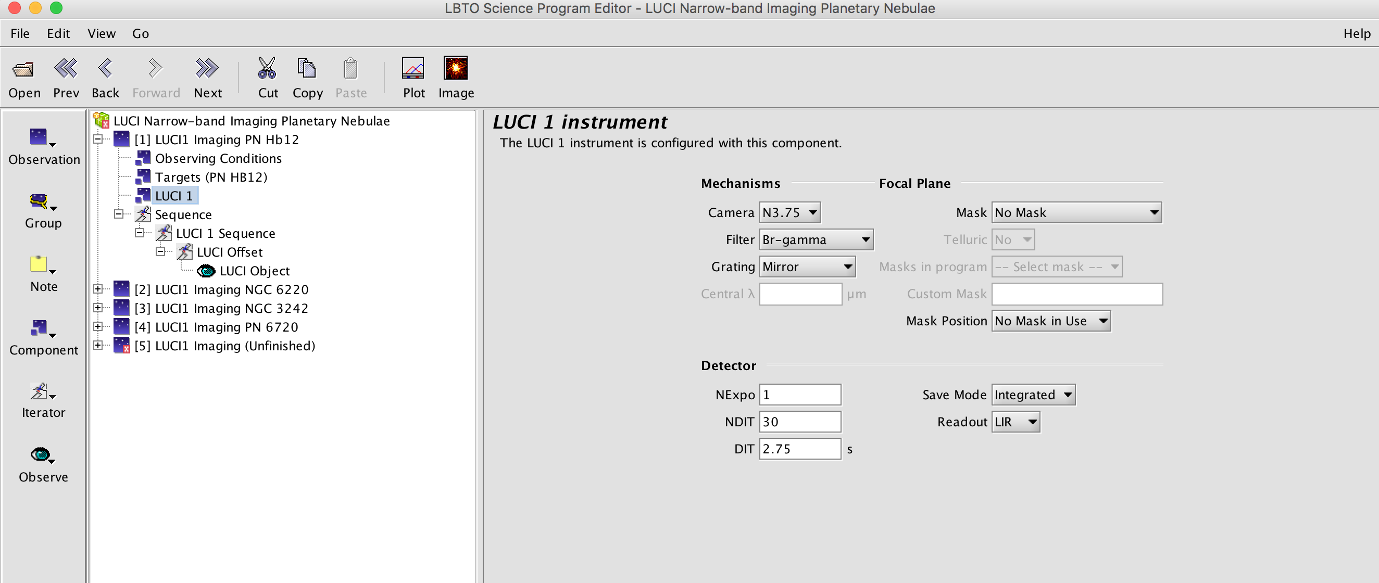
LBTO Phase II Observing Tool

Slide 12
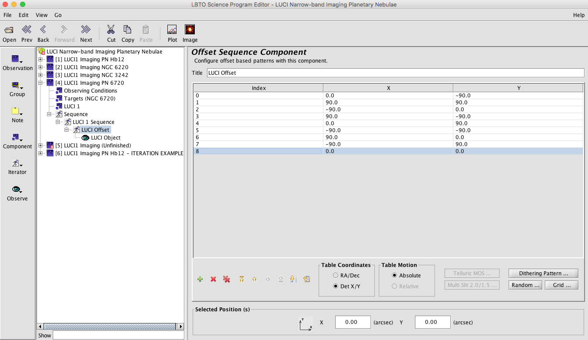
LBTO Phase II Observing Tool

Slide 13
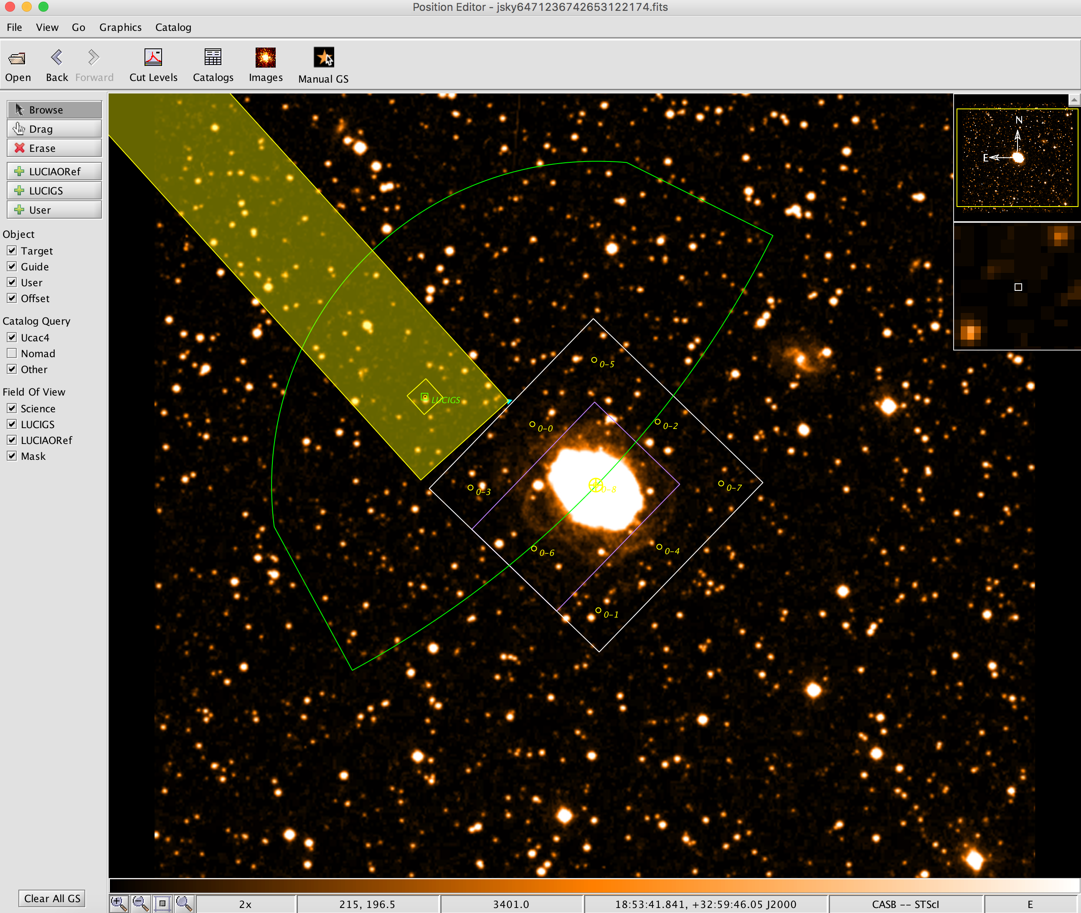
Built-In Tools: Position Editor
The Position Editor allows users to see catalog images of their source with the FOV of the detector and any patrol fields overlaid
Interaction with the Position Editor also allows for real-time guide star selection

Slide 14
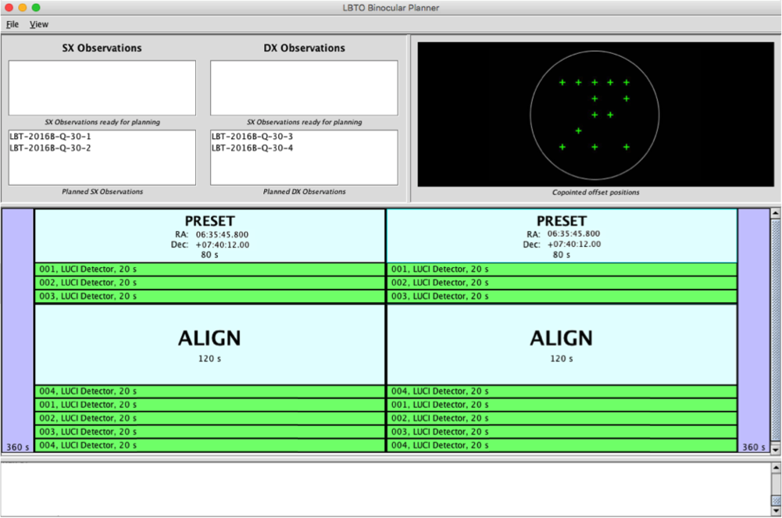
Built-In Tools: Binocular Tool
Necessary for planning full-binocular observations (mixed instruments, mixed modes, different offsets/PAs )
Design phase complete; coding about 50% complete
Some challenges? As observatory’s experience with binocular observing grows, tool could evolve!
Want to hear from YOU. What modes should we work on first? Is “full-binocular” important or should we expand “fraternal-binocular” first?

Slide 15
**WORKSHOP: Tomorrow 16:00-18:00**

Slide 16
OT Deliverables
OT Beta released in 2016B
“Prime” version released for public use in 2017A.
Team will continue development, anticipating that as we release new user tools in 2017-2018 that benefit the community, excitement will grow
Extensive documentation (webpages) also released in 2017A
Binocular planner release will depend on community desires
Community testing and feedback is needed and welcome!

Slide 17
What’s Next
New instrumentation in OT: Flexible enough to include LBTI, PEPSI SHARK, ARGOS etc.
Phase III Tool? A smart real-time plan during nighttime operations
Environmental sensors integration and improved predictions of observing conditions by Arcetri
A real-time data qualification tool (RTDT) to evaluate seeing, etc. expected in 2017B

Slide 18
Questions?
Acknowledgement:
LBTO wishes to thank Gemini Observatory for making their code easily available to the community and for their support to LBTO staff during our software evaluation and site visit to Gemini South.

